Slide 1

Quarterly Marketing Review

Slide 2
Agenda Items
H+ Sport campaign overview
Marketing materials
Product focus
Results
Summary & goals

Slide 3
Campaign Overview
Inspirational marketing, with exceptional sports photography, delivered through social media advertising

Slide 4
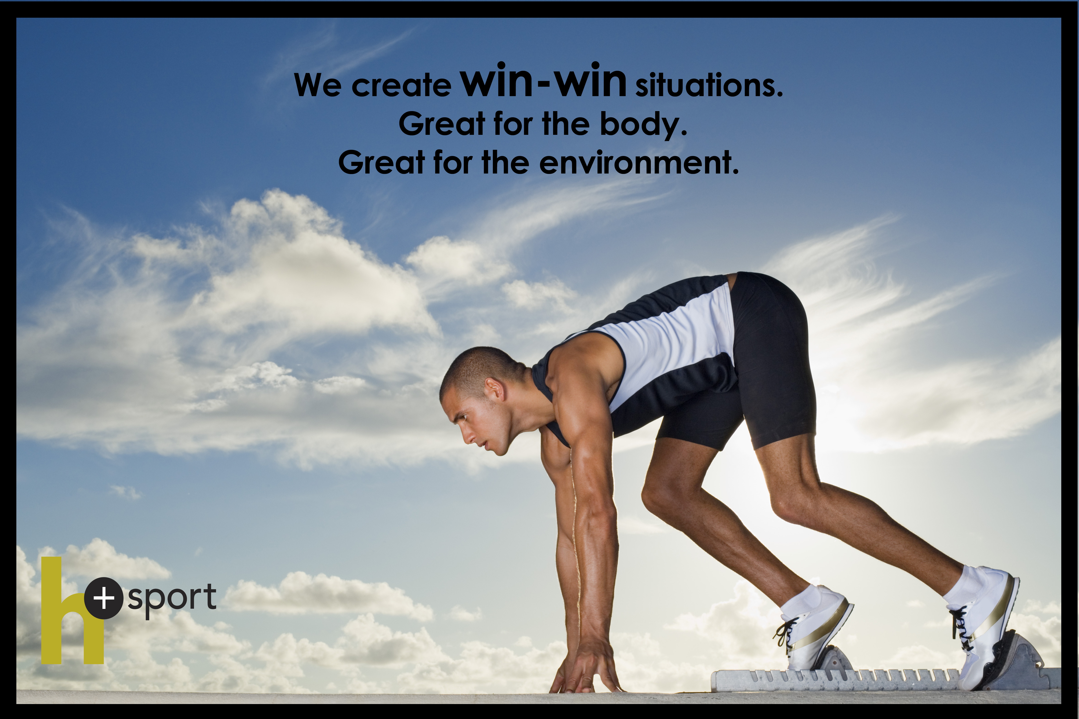

Marketing Materials

Slide 5
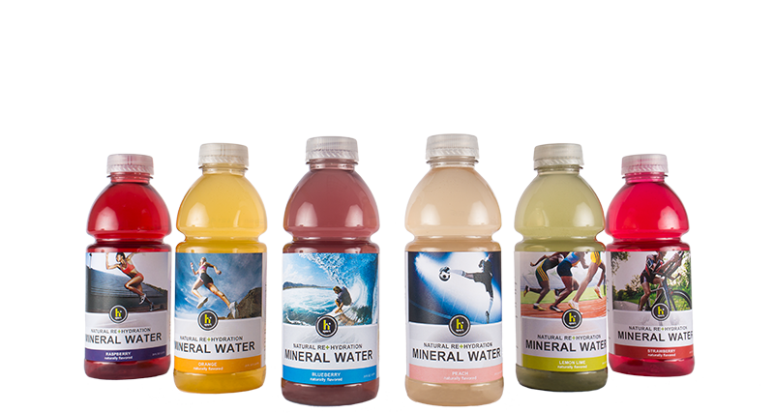
Product Focus

Slide 6
H+ Sport Mineral Water
Natural rehydration. Everything you need, nothing you don’t.
Six refreshing flavors
12 vitamins and minerals in each 8-ounce serving
Made in the USA with USA-sourced ingredients
Contains no artificial flavors, colors, preservatives, or sugar

Slide 7
Results
WEEK | AD CLICKS
1 | 13
2 | 45
3 | 132
4 | 258
5 | 267
6 | 329
7 | 459
8 | 576
9 | 724
10 | 1012
11 | 1305
12 | 1487

Slide 8
Summary & Goals
Social media marketing campaign, with emphasis on mineral water products, significantly increased site visitors over the 12-week case study
Goals:
Hire one full-time social media specialist to manage and expand campaign
Hire two contract graphic designers to create marketing materials

